Slide 1
Big data project
The Book Crossing (BX) Dataset
Submitted by: Dana Hadar, Mazal Gonen, Inna Rozner

Slide 2
Data set preparation and cleaning
The preparation and the cleaning was performed in the following steps:
A notebook was created using the google colab with a spark environment
A connection between colab and google drive was established and spark libraries were imported
Cleaning of the dataset-general:
Each file was imported to a spark data frame
All column names were transformed to lower case
All null, none, nan were cleaned. ALL string types were transformed to “unknown”, int types were transformed to “-1”.
Duplicated line were dropped.

Slide 3
Data set preparation and cleaning (continued)
Cleaning of the dataset-users:
We assume valid age is between 1 and 120. for children, we assumed parents made the ratings.
age- when null, zero or more than 120 the value entered was “-1”
An age category was added for a more informative analysis in Tableau.
Country- the column was cleaned from all incorrect characters, such as symbols and numbers. Then, common mistakes were cleaned manually. finally, lists of countries and states in the USA were downloaded from the net, the files were converted to lists using a loop. a comparison was made between the dataset and the lists in 2 iterations in order to determine the validity of the country: first in the country list, then we deduced the country name (USA) from the states list. After this process 6,257 country records remained unknown.
City and state columns were cleaned from all incorrect characters, such as symbols and numbers.

Slide 4
Data set preparation and cleaning (continued)
Cleaning of the dataset-books:
ISBN- first it was cleaned from all incorrect characters, such as symbols. All alpha-numeric characters were kept. A valid ISBN consists of 10 or 13 characters. A10 character ISBN consists of 10 digits or 9 digits and “X” in the end. A 13 characters ISBN is based on the 10 characters with 978 or 979 in the beginning. All cleaning steps performed were based on the described structure.
Then, we downloaded the library “isbnlib”, built a UDF that checks the validity of the ISBN from the spark dataframe in accordance with the data in the library. a Boolean column with the results was added to the data frame.
Year- this parameter ranges between 0-2050 in the data set. There were 4,557 and 13 records containing year 0 and over 2022, respectively. These were converted to “-1”.

Slide 5
Data set preparation and cleaning (continued)
Cleaning of the dataset-books- continued:
Titles, images- we checked duplicated titles and images to insure they had different ISBNs. No duplicated images found and all duplicated titles had indeed different ISBNs.
Author, Publisher- we checked for invalid characters, such as numbers and symbols. No results were detected.

Slide 6
Data set preparation and cleaning (continued)
Cleaning of the dataset-rating:
Ratings- we expected ratings in the range of 1-10, however, 651,328 (approximately 2/3 from the data) were zero. All ratings were kept, zero ratings were not considered for AVG ratings. The average rating is 7.6.
ISBN- all the steps performed in the books file were performed in the rating file as well.
Null ratings were dropped.
Unknown member- we checked that all ISBNs in the rating file exist in the books file. The “ISBN_UKM” column was adjusted with “9999” for all unknown members. We also added a row for unknown member to the books file.
All cleaned files were exported to csv files.

Slide 7
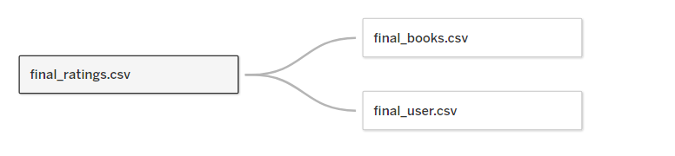
Analyzing data set with tableau
The following connections were made creating a model:
glossary:
Top 10 or Top 5 always refer to top rated (including rating 0)
Avg rating calculated based on ratings of 1-10.
We have 106, 739 “unknown members”, namely, books that were rated , but don’t exist in the books file. Unknown members were filtered through the entire descriptive process.

Slide 8
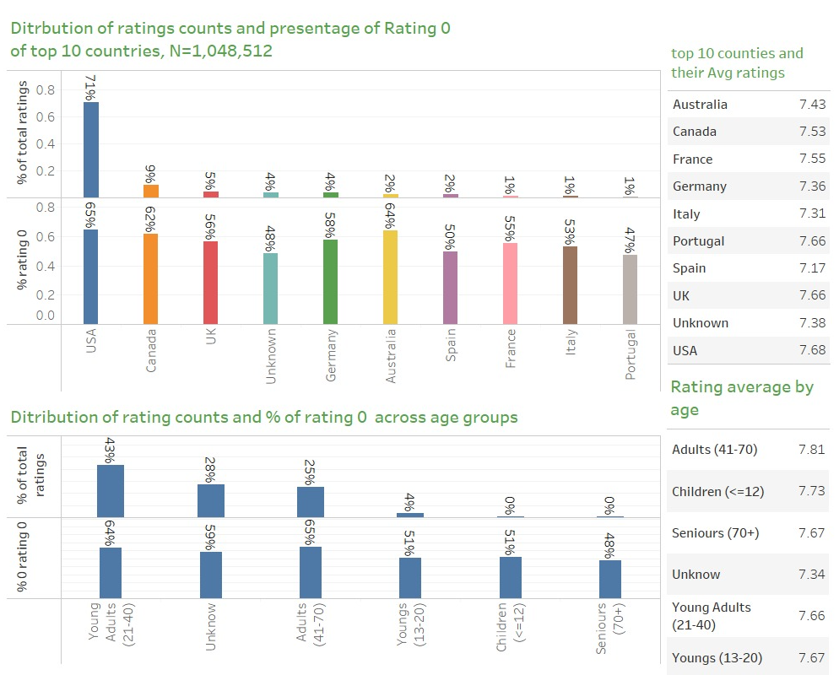
Analyzing data set with tableau
Figure 1 demonstrates most of the ratings came from English spoken countries :USA(71%), Canada (9%) and the UK (5%), in most countries more than half of the ratings are not valid (Rating =0).
Grouping by age shows that most ratings were made by young adults (age 21 – 40) and adults (age 41 to 70) , in both age groups most of the ratings are not valid (Rating =0).
Avg rating is between 7.3 to 7.8 across age groups, the adults group have the highest avg rating while the unknown age group has the lowest.
Avg rating is between 7.2 to 7.7 across top 10 countries, raters from USA have the highest avg rating while raters from Spain have the lowest.

Slide 9
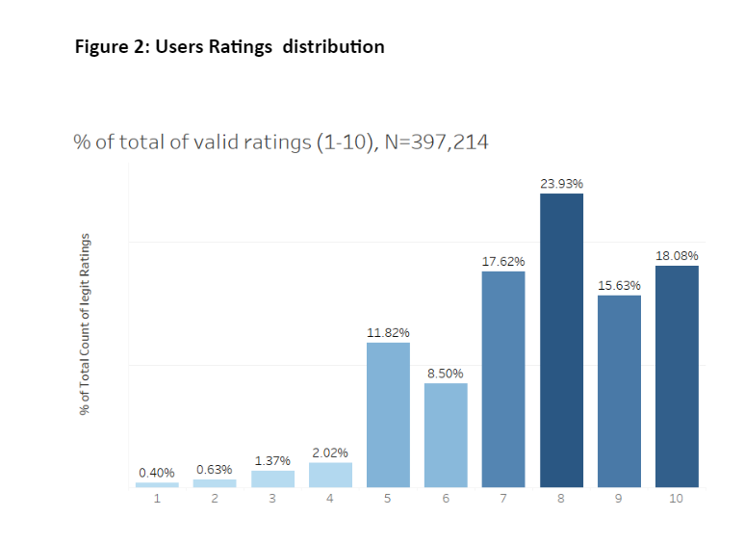
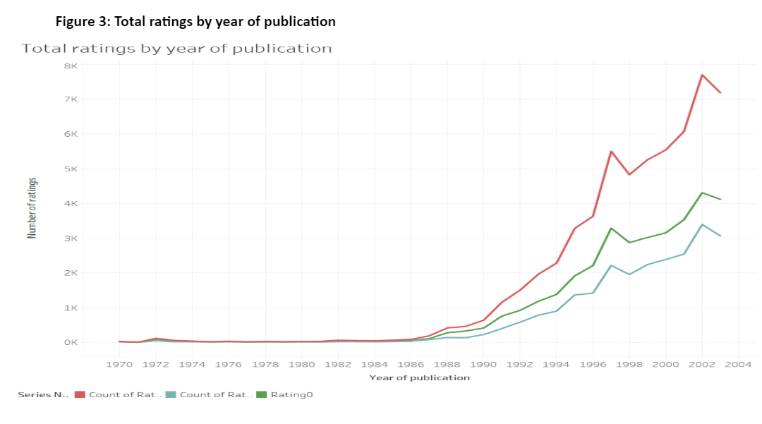
Analyzing data set with tableau
Most of the raters rated 8,10 or 7.
Figure 3 demonstrates that books published in 2002 were most rated.

Slide 10
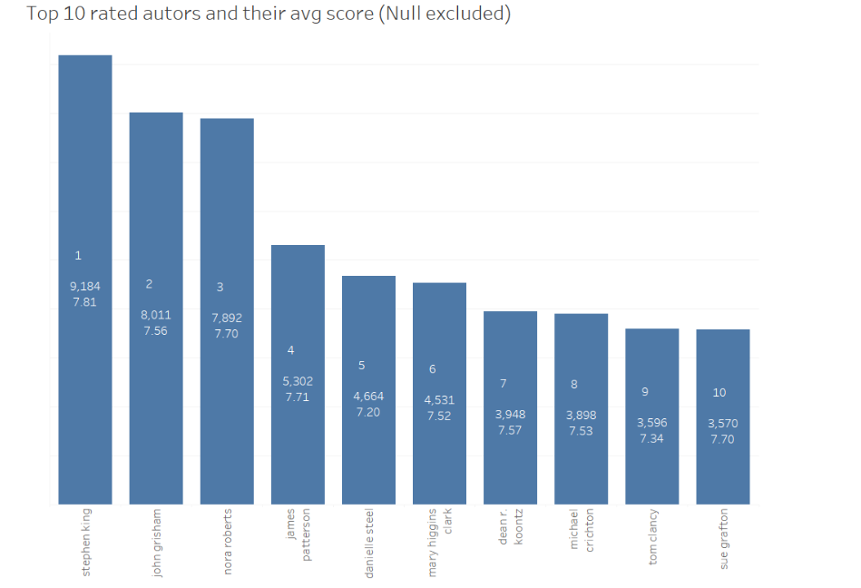
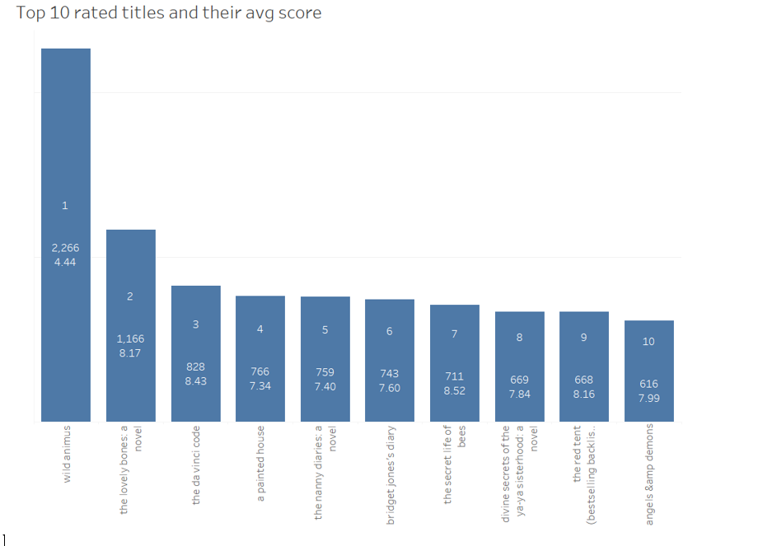
Analyzing data set with tableau
Figure 4 demonstrates most rated authors and their AVG score. We can see that Stephen King & John Grisham are most rated while Stephen King and Nora Roberts are most liked.
Figure 5 demonstrates that the most rated title is “wild animus“, however, it has the lowest avg rating. The secret life of bees was the most liked among it’s readers.

Slide 11
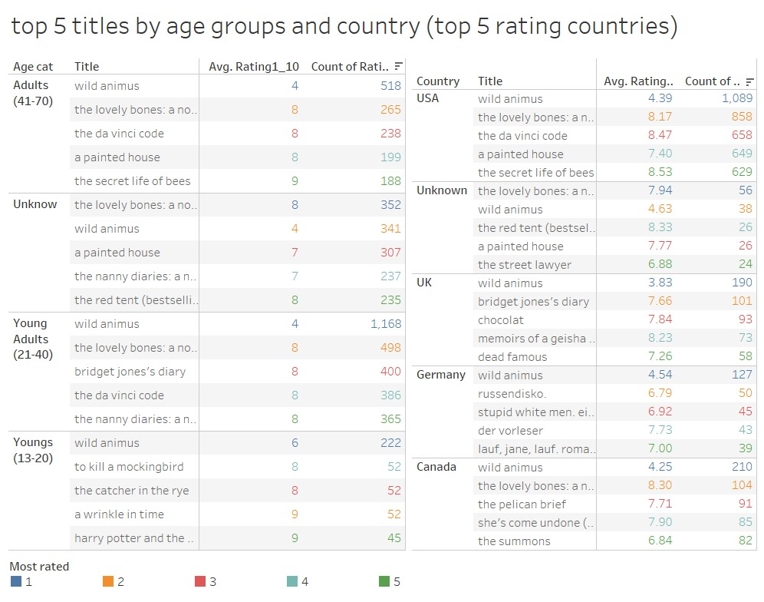
Analyzing data set with tableau
Figure 6 demonstrates “wild animus” is the most rated title across all ages and countries, however it is not valued much by its readers. “Lovely Bones” is also highly rated across age groups, except for youngers in USA and Canada. This book received ratings above average.

